Slide 1
Lecture 8: Fuzzy Logic
Introduction
Dr Samar Hesham
Department of Computer Science Faculty of Computers and Artificial Intelligence
Cairo University
Egypt
1

Slide 2
ORIGINS OF FUZZY LOGIC
Professor Lotfi Zadeh, UC Berkeley, 1965
“People do not require precise numerical information
input, and yet they are capable of highly adaptive control.”
Accepts noisy, imprecise input!
Fuzzy logic can be defined as a superset of conventional (Boolean) logic that has been extended to handle the concept of partial truth - truth values between “completely true” and “completely false”
5

Slide 3
WHAT IS FUZZY LOGIC?
Is a form of knowledge representation suitable for notions that cannot be defined precisely, but which depend upon their contexts.
A computational paradigm that is based on how
humans think
Is based on the idea that all things admit of degrees. Temperature, height, speed, distance, beauty – all come on a sliding scale.
The motor is running really hot.
Tom is a very tall guy.
6

Slide 4
WHAT IS FUZZY LOGIC?
Boolean logic uses sharp distinctions. It forces us to draw lines between members of a class and non- members. For instance, we may say, Tom is tall because his height is 181 cm. If we drew a line at 180 cm, we would find that David, who is 179 cm, is small. Is David really a small man or we have just drawn an arbitrary line in the sand?
Fuzzy logic reflects how people think. It attempts to model our sense of words, our decision making and our common sense. As a result, it is leading to new, more human, intelligent systems.
7

Slide 5
WHAT IS FUZZY LOGIC?
logic that extended the range of truth values to all real numbers in the interval between 0 and 1. He used a number in this interval to represent the possibility that a given statement was true or false. For example, the possibility that a man 181 cm tall is really tall might be set to a value of
0.86. It is likely that the man is tall. This work led to an inexact reasoning technique often called possibility theory.
8

Slide 6
WHAT IS FUZZY LOGIC?
Fuzzy logic is a set of mathematical principles for knowledge representation based on degrees of membership.
Unlike two-valued Boolean logic, fuzzy logic is
multi-valued. It deals with degrees of membership and degrees of truth.
Fuzzy logic uses the continuum of logical values between 0 (completely false) and 1 (completely true). Instead of just black and white, it employs the spectrum of colours, accepting that things can be partly true and partly false at the same time.
9

Slide 7


Sample Applications
In the city of Sendai in Japan, a 16-station subway system is controlled by a fuzzy computer (Seiji Yasunobu and Soji Miyamoto of Hitachi) – the ride is so smooth, riders do not need to hold straps
Nissan – fuzzy automatic transmission, fuzzy anti-skid braking system
CSK, Hitachi – Hand-writing Recognition
Sony - Hand-printed character recognition
Ricoh, Hitachi – Voice recognition
Tokyo’s stock market has had at least one stock-trading portfolio based on Fuzzy Logic that outperformed the Nikkei exchange average

Slide 8

Sample Applications
NASA has studied fuzzy control for automated space docking: simulations show that a fuzzy control system can greatly reduce fuel consumption
Canon developed an auto-focusing camera that uses a charge- coupled device (CCD) to measure the clarity of the image in six regions of its field of view and use the information provided to determine if the image is in focus. It also tracks the rate of change of lens movement during focusing, and controls its speed to prevent overshoot.
The camera's fuzzy control system uses 12 inputs: 6 to obtain the current clarity data provided by the CCD and 6 to measure the rate of change of lens movement. The output is the position of the lens. The fuzzy control system uses 13 rules and requires 1.1 kilobytes of memory.
http://en.wikipedia.org/wiki/Fuzzy_system

Slide 9
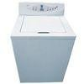

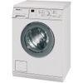
Sample Applications
For washing machines, Fuzzy Logic control is almost becoming a standard feature
fuzzy controllers to load-weight, fabric-mix, and dirt sensors and automatically set the wash
cycle for the best use of power, water, and detergent.
GE WPRB9110WH Top Load Washer
Haier ESL-T21 Top Load Washer
LG WD14121 Front Load Washer
Miele WT945 Front Load All-in-One Washer / Dryer AEG LL1610 Front Load Washer
Zanussi ZWF1430W Front Load Washer
Others: Samsung, Toshiba, National, Matsushita, etc.

Slide 10
WHAT IS FUZZY LOGIC?
Fuzzy logic:
A way to represent variation or imprecision in logic
A way to make use of natural language in logic
Approximate reasoning
Humans say things like "If it is sunny and warm today, I will drive fast"
Different Measures:
Temp: {freezing, cool, warm, hot, very hot}
Cloud Cover: {overcast, partly cloudy, sunny}
Speed: {very slow, slow, fast, very fast}

Slide 11
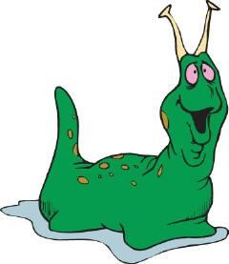

TRADITIONAL REPRESENTATION OF LOGIC
Slow
Speed = 0
Fast
Speed = 1
bool speed;
// get the speed
if ( speed == 0)
{
// speed is slow
}
else
{
// speed is fast
}

Slide 12


FUZZY LOGIC REPRESENTATION
Some problems must be represented in terms of fuzzy sets.
Slowest
[ 0.0 – 0.25 ]
Slow
[ 0.25 – 0.50 ]
What are Fuzzy Sets?
Fast
[ 0.50 – 0.75 ]
Fastest
[ 0.75 – 1.00 ]

Slide 13
FUZZY LOGIC REPRESENTATION
Slowest
Slow
float speed;
// get the speed
Fast
Fastest
if ((speed >= 0.0)&&(speed < 0.25))
{
// speed is slowest
}
else if ((speed >= 0.25)&&(speed < 0.5))
{
// speed is slow
}
else if ((speed >= 0.5)&&(speed < 0.75))
{
// speed is fast
}
else // speed >= 0.75 && speed < 1.0
{
11/26/2020
// speed is fastest
17
}

Slide 14




















ANOTHER EXAMPLE
A class of students
(e.g. Students learning “Fuzzy Logic”)
The universe of discourse: X
“Who does have a driving licence?”
A subset of X = a (Crisp) Set
χ(X) = CHARACTERISTIC FUNCTION
1
0
1
1
0 1 1
“Who can drive very well?”
μ(X) = MEMBERSHIP FUNCTION
0 0.4 0.2
FUZZY SET
0.7 0
1.0 0.8
11/26/2020
18

Slide 15
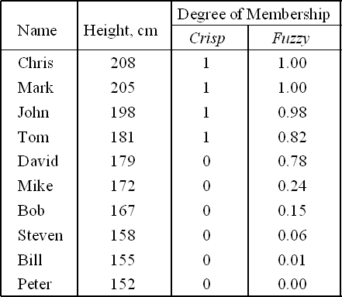
Fuzzy Sets
Fuzzy Sets can represent the degree to which a quality/degree is possessed.
Fuzzy Sets (Simple Fuzzy Variables) have values in the range of [0…1]
The classical example in fuzzy sets is tall men. The elements
of the fuzzy set “tall men” are all men, but their degrees of membership depend on their height.

Slide 16
Fuzzy Sets
The x-axis represents the universe of discourse – the range of all possible values applicable to a chosen variable. In our case, the variable is the man height. According to this representation, the universe of men’s heights consists of all tall men.
The y-axis represents the membership value of the fuzzy set. In our case, the fuzzy set of “tall men” maps height values into corresponding membership values.
Degree of Membership
Crisp Sets
1.0
0.8
0.6
0.4
0.2
0.0
210
Height, cm
150
160
170
180
190
200
Degree of Membership
Fuzzy Sets
1.0
0.8
0.6
0.4
0.2
0.0
150
160
170
180
190
200
210
Height, cm

Slide 17
Fuzzy Sets
Let X be the universe of discourse and its elements be denoted as x. In the classical set theory, crisp set A of X is defined as function f_{A} (x) called the characteristic function of A
f (x): X -> {0, 1}, where
_{(x) =} ⎧1, if x ∈ A
f
A
⎨
A
⎩0, if x ∉ A
In the fuzzy theory, fuzzy set A of universe X is defined by function m_{A} (x) called the membership function of set A
m_{A}(x): X -> [0, 1], where
m_{A}(x) = 1 if x is totally in A; m_{A}(x) = 0 if x is not in A;
0 < m_{A}(x) < 1 if x is partly in A.

Slide 18
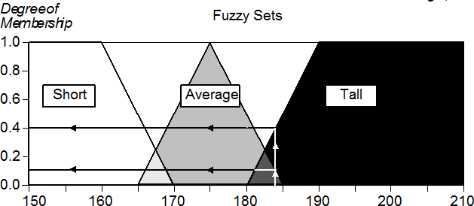
Example 1
men’s height: {short, average, tall}
Question: How tall is man with 184 cm?
Answer: a man who is 184 cm tall is a member of the average set with a degree of membership of 0.1, and at the same time, he is also a member of the tall set with a degree of 0.4.

Slide 19
Example 2
Temp: {Freezing, Cool, Warm, Hot}
Question: What is the temperature?
Answer: It is warm.
Question: How warm is it?
Membership Function

Slide 20
Membership Functions
Temp: {Freezing, Cool, Warm, Hot}
Degree of Truth or "Membership"
1
Freezing
Cool
Warm
Hot
0
10
30
50 70
Temp. (F°)
90
110

Slide 21
Membership Functions
How cool is 36 F° ?
1
Freezing
Cool
Warm
Hot
0
10
30
50 70
Temp. (F°)
90
110

Slide 22
Membership Functions
How cool is 36 F° ?
It is 30% Cool and 70% Freezing
1
Freezing
Cool
Warm
Hot
0.7
0.3
0
10
30
50 70
Temp. (F°)
90
110

Slide 23
Membership Functions
Shape of membership function is usually triangle
(but could also be trapezoidal or other)
Height usually normalized to 1 (so in total: [0..1])
Width of the base of function depends on number of functions
Center points of functions evaluate to 1

Slide 24
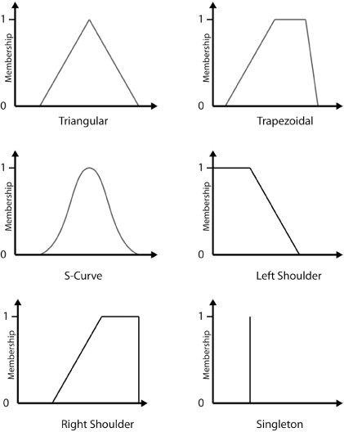
Well known Membership Functions
For triangular fuzzy sets:
A fuzzy set can be defined by 3 points {a, b, c} on the X-axis, where membership of a and c are zeros, while membership of b is one.
For trapezoidal fuzzy sets:
A fuzzy set can be defined by 4 points {a, b, c, d} on the X-axis, where membership of a and d are zeros, while membership of b and c is one.
30

Slide 25
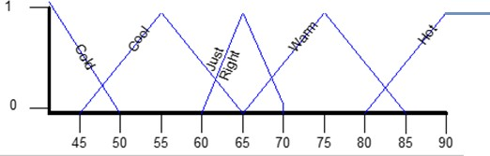
Examples
Air Temperature
Set cold {0, 0, 50}
Set cool {45, 55, 65}
Set just right {60, 65, 70}
Set warm {65, 75, 85}
Set hot {80, 90, ∞, ∞}
1
Slow
Fast
Speed
Set slow {0, 0, 25,75}
Set fast {25, 75,∞, ∞}
0
50 75
Speed (mph)
0
25
100
31

